Slide 1

Building
Renovations
August 2025

Slide 2
Presentation Structure
What? Why? When?
The Big Questions
Detailed Floorplan Review

Slide 3
What? Why? When?

Slide 4
What Are We Doing?
$1 million Building Renovation to:
Improve Flexibility of the Building
Enhance Member Experience
Offer New Opportunities

Slide 5
What Are We Doing?
Substantial Improvements include:
Updated Education Center
Additional Classroom
Enhanced Member Areas
Redesigned Reception Area

Slide 6
What Are We Doing?
Flexible Spaces to Meet a Variety of Needs
Casual Meeting Room : 4-6 Members
Regency Room: 6-12 Members
Board Room: 8-20 Members
Second Classroom: 12-40 Members
Education Center: 40-100+ Members

Slide 7
Why Are We Doing It?
More Efficient Layout
Updated Technology
More Inviting Atmosphere
Modernized Facility for Membership
Remove Safety Hazards
Maintain the Value of Our Largest Fixed Asset
Notes:
……..to make the most use of our 10,500 square foot

Slide 8
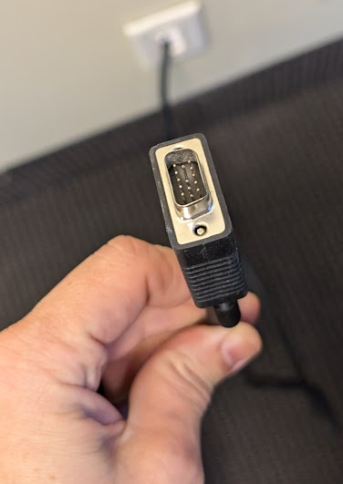
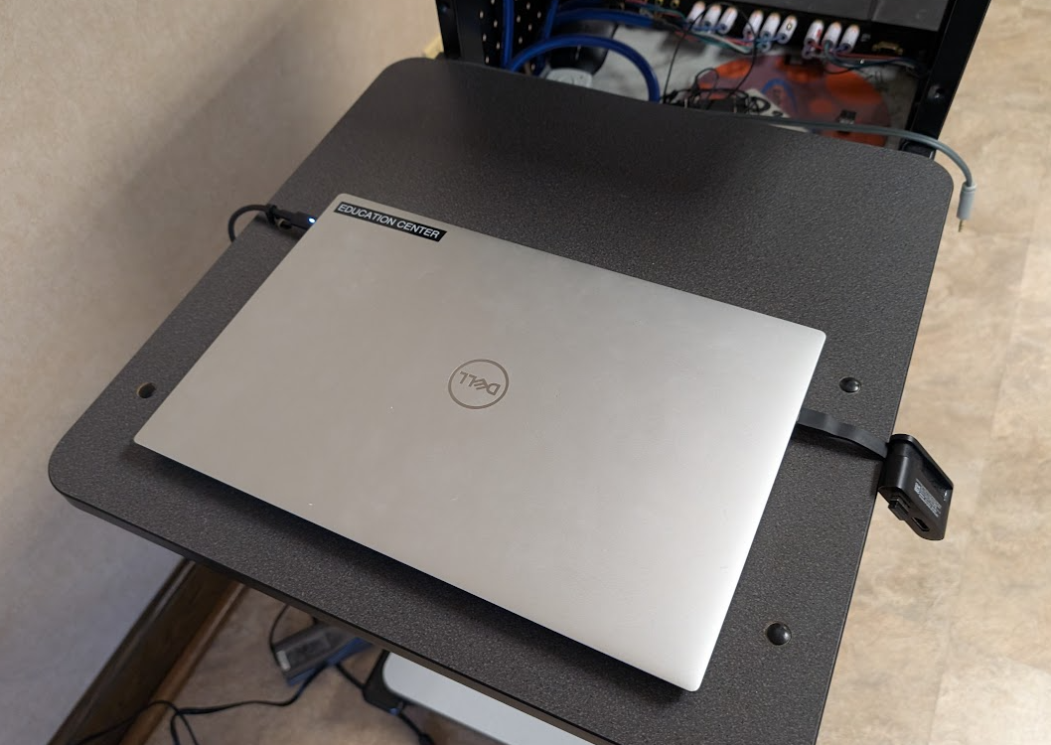
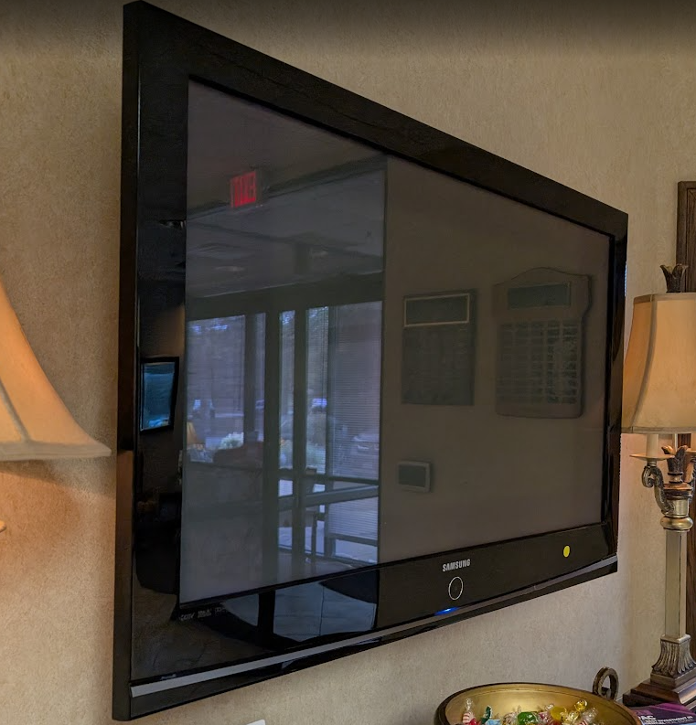
Why Now?
Failing Technology
Notes:
Add feedback from members about bad sound/video in the education center
Education Center technology has not been updated in two decades

Slide 9
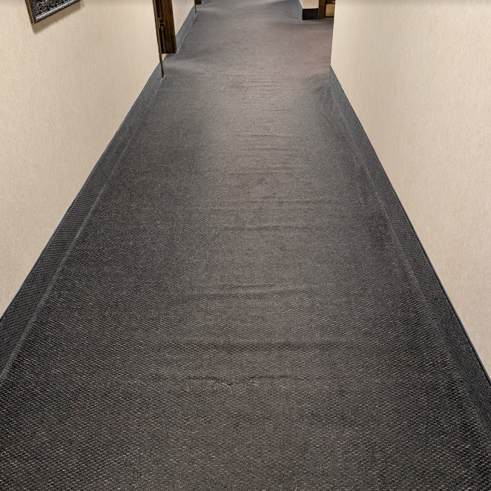

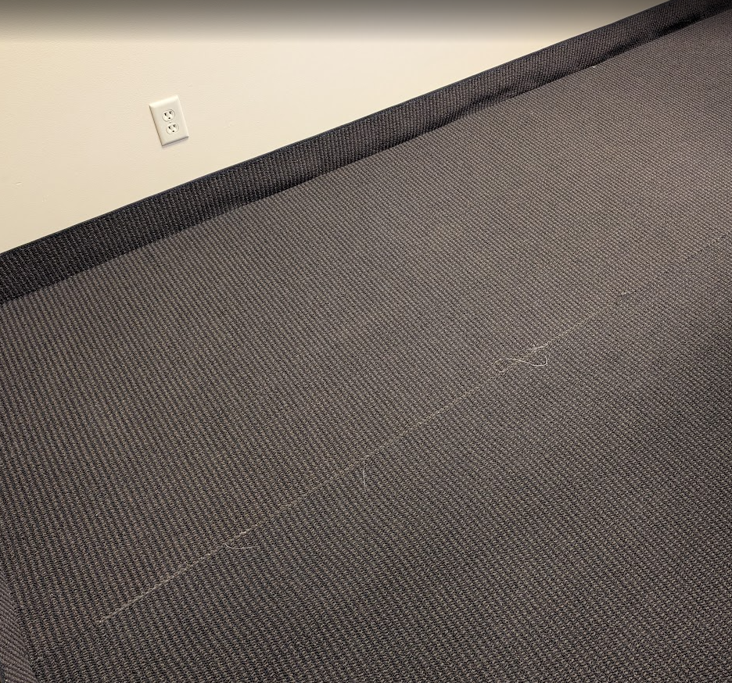
Why Now?
Failing Technology
Carpet Tripping Hazard

Slide 10
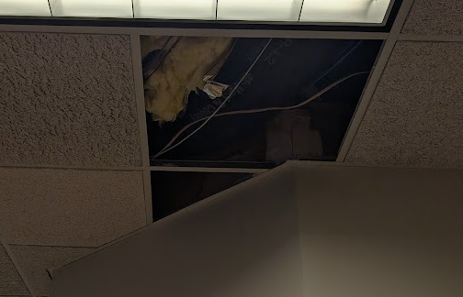
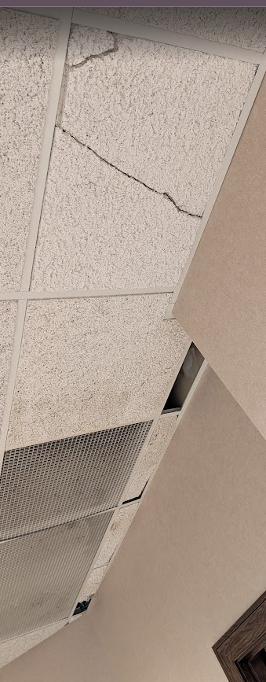
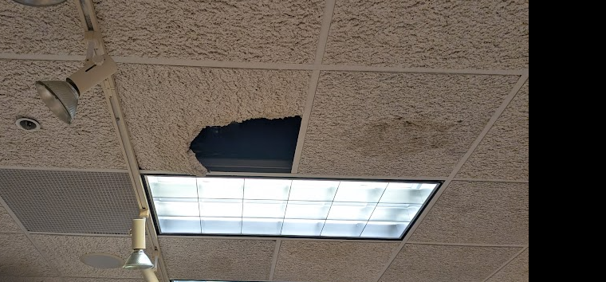
Why Now?
Failing Technology
Carpet Tripping Hazard
Damaged Ceiling Tiles from Leaks
Roof replaced July 2025
Notes:
Roof already completed and paid for out of reserves, not part of the renovation budget.

Slide 11
Why Now?
Failing Technology
Carpet Tripping Hazard
Damaged Ceiling Tiles from Leaks
Roof replaced July 2025
Failing Light Switches and Fixtures
General Wear and Tear
?? Years Since Last Upgrade

Slide 12
When Are We Doing It?
Building Task Force and Board of Directors have been considering building upgrades for the last 5+ years.
July 2025 – Board of Directors approved $1 million building renovation budget to be presented to membership.
August 2025 – 2 Member Forums and 2 Broker Forums to discuss building renovation.

Slide 13
When Are We Doing It?
August 28th – September 3rd – Vote to approve or deny the building renovations on your Election Ballot.
Why the vote? Any capital expenditure in excess of twenty-five percent of annual revenues must be approved by Association Membership.
If approved, renovations would begin during the 4th Quarter of 2025, and complete sometime in January 2026.

Slide 14
The Big Questions

Slide 15
Big Questions
Can we afford this?
Bluegrass REALTORS is healthy financially. Our months of reserves would decrease by about four months with this expenditure.
Will we need to take out a loan?
No. The Association has enough cash on hand to cover the entire project.

Slide 16
Big Questions
Will my dues increase because of this?
While a dues increase is an ongoing consideration due to inflation, we do not anticipate an increase directly related to this decision.
Notes:
The dues you have seen are from state and national.
Dues increases are more tied to annual revenue versus expenses rather than amount of cash in the bank.
Reserves are for rainy days and capital expenditures like this one.
Pulling operational budgets out of reserves on an ongoing basis is not a long-term strategy for success.

Slide 17
Big Questions
What about live classes? December is a busy time!
We are making all efforts to not cancel any Live classes currently on the calendar.
We will find temporary space in public libraries, hotel conference rooms, or anything else necessary to retain your in-person class experience.
Where will we go for lockboxes?
We are looking at options to secure temporary space to ensure the excellent member experience you have had will continue.

Slide 18
Big Questions
Why make changes to the whole building?
As it became clear that the necessary changes would require a member vote, it became clear that now would be the time to do the whole thing at once.
Why not do this in phases?
Doing these projects in phases can become expensive because of the lack of cost savings of already having people and materials on site.

Slide 19
Big Questions
How did we choose the contractor?
The project has been put to bid multiple times, with the most recent round going to three different contractors.
After the Building Task Force reviewed the bids, they recommended Brett Construction Company.
The Board of Directors was presented with all of the bids and the Task Force’s recommendation, and ultimately agreed with that decision.

Slide 20
Big Questions
I don’t live or work in Lexington. How does this benefit me?
Education Center upgrades will drastically improve the video and audio quality for remote access.
Updates include new microphones, speakers, two cameras, and a video wall that will improve the experience.
Our building is the face of our brand, and influences the perception of media, elected leaders, or other business leaders.
Notes:
Every time we hold Member/Broker Forums or other non-CE presentations in this space, we receive complaints about poor sound or video quality because we have been using old equipment and a solution meant for a much smaller room.

Slide 21
Big Questions
What is the breakdown of the $1 million?
$431,000 – General Construction and Updates
$192,000 – Technology Upgrades
$282,000 – Furniture, Cabinetry, Décor, Artwork
$95,000 – Miscellaneous Costs, Unforeseen Issues
Total Budget: $ 1 million

Slide 22
Big Questions
What if the renovation goes over budget?
The Building Task Force and Board of Directors will maintain continuous oversight of the project to ensure expenses are properly tracked and will work diligently to remain under budget.
However, as with any renovation project, unforeseen issues can arise, which is why there is a little buffer built in.
If that were to happen, it would be noticed to membership and be made extremely transparent.

Slide 23
Big Questions
Is there a plan to evaluate the return on investment?
There are no plans to sell the building, so increasing the value on the building is not top of mind.
We will continue to measure member satisfaction through the annual survey that we started this year.
Comments on that survey asked for more live classes, better sound quality, and more remote options. Survey results also ranked Education is the #1 most important benefit to your business, and the #1 place you want us to put the most emphasis.
Notes:
1. How is commercial value calculated?
Commercial buildings are often valued based on income they can produce, using a formula:
Value = Net Income / Cap Rate
Net Income (NOI) = Rent collected minus expenses (like taxes and insurance).
Cap Rate = A percentage return investors expect from buying the building. (Think of it like an interest rate — lower = higher value.)
💰 After the Renovation
He believes you could rent the space for $16 to $18 per square foot per year.
Your building is 10,635 square feet, so at $16/sf, that’s $170,160/year in rent.
Subtract 20% for expenses (roughly $34,000), you’re left with $136,128 in profit (NOI).
Using an 8% cap rate, that means:
$136,128 ÷ 0.08 = $1.7 million building value Or about $160 per square foot
💵 Before the Renovation
Right now, he thinks you’d only get $14/sf in rent.
That’s $148,890/year in rent, minus 20% = $119,112 in profit (NOI).
Using the same cap rate:
$119,112 ÷ 0.08 = $1.49 million value Or about $140 per square foot
✅ The Bottom Line:
Current building value: $1.49 million
Estimated value after $1M renovation: $1.7 million or more
Increase in value: About $210,000, possibly more depending on rental rate
🧠 Key Things to Know
Commercial buildings are valued like investments, not based on comps like residential. The more income it produces, the more it's worth.
The renovation helps you raise rents, which in turn raises the value of the building.
The value gain in this case doesn't fully match the $1M spent — so it’s not a pure investment ROI — but there may be non-monetary returns, like improved function, modern appeal, better use of space, or long-term positioning.

Slide 24
Detailed Floorplan Review

Slide 25
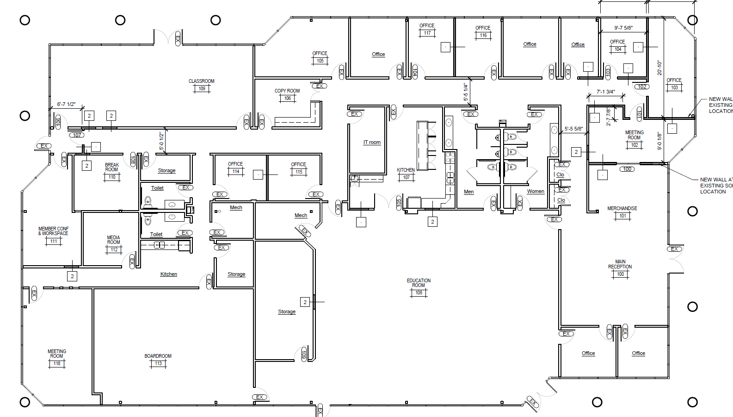
Detailed Floorplan Review
Notes:
Point out removed walls to make room for new classroom
Point out new walls to make new meeting room and two offices
Point out removed wall to expand education center
Moving Member Workspace to the back

Slide 26
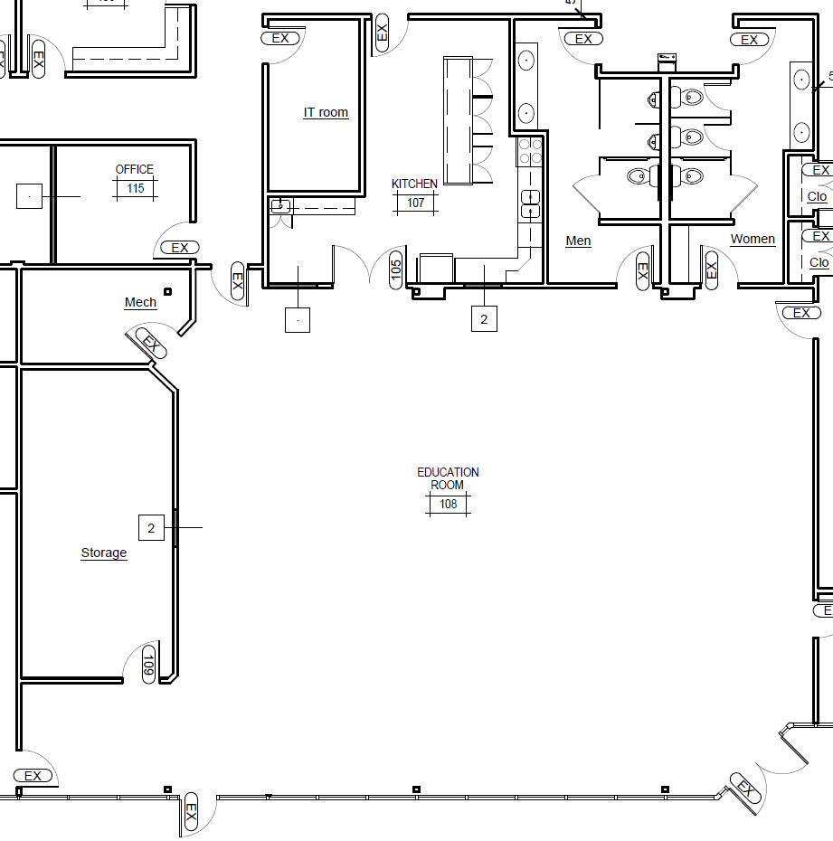
Education Center
Eliminate hallway to expand the space for more seating.
Double door into kitchen, with dedicated island for food service.
New Beverage Counter to improve flow.

Slide 27
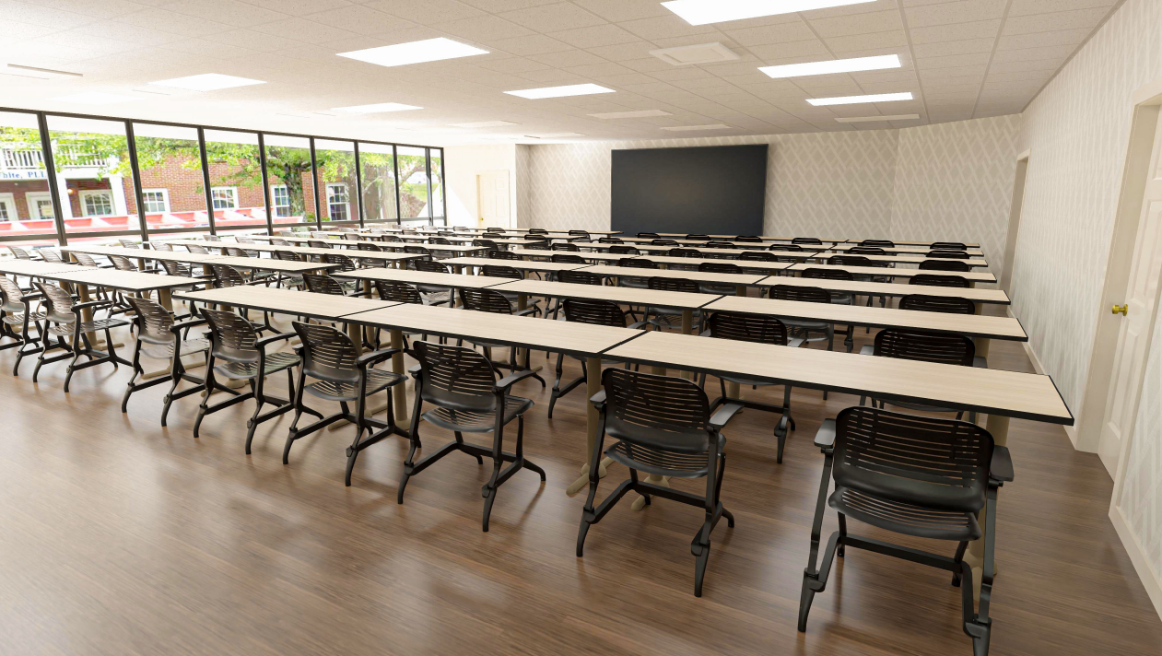

Slide 28
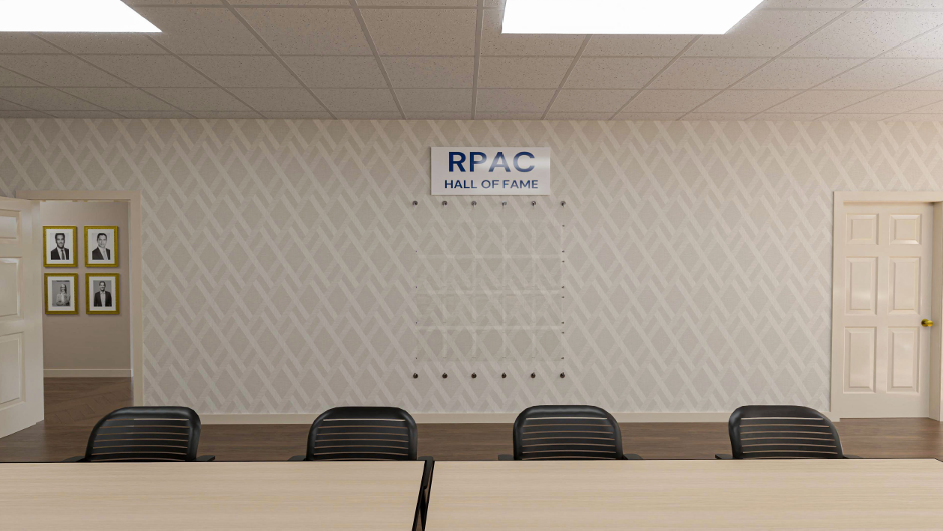

Slide 29
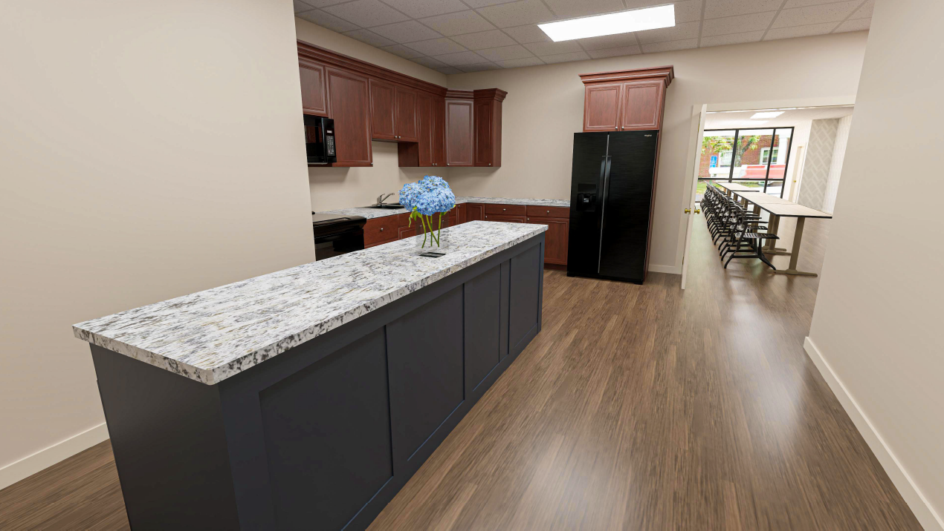

Slide 30
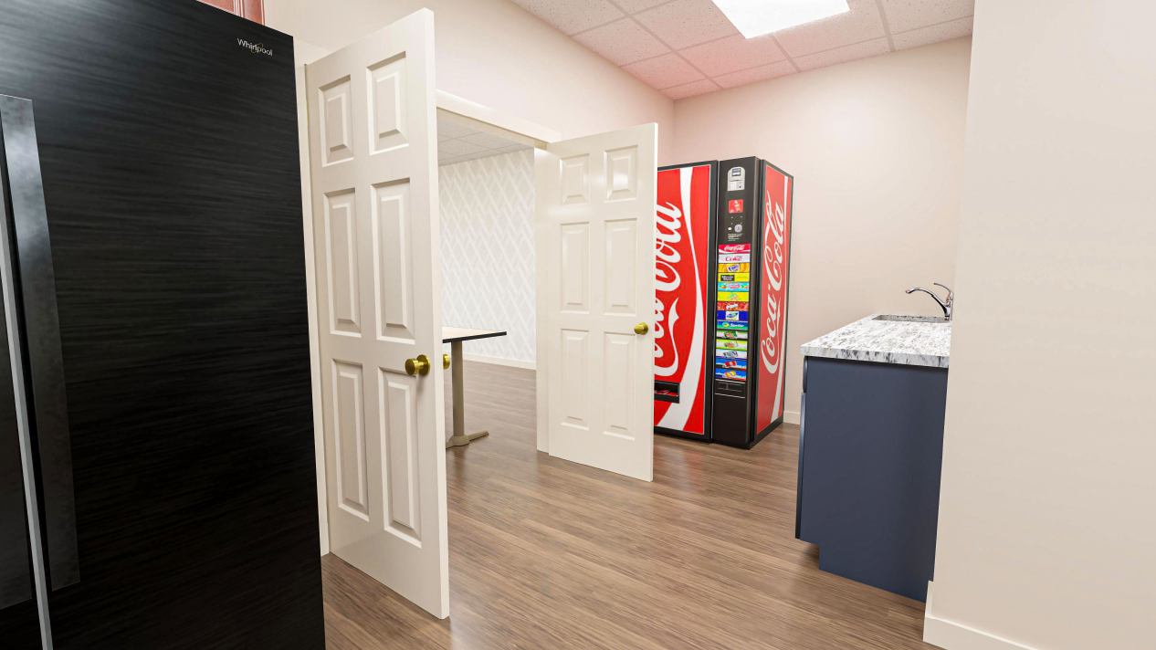

Slide 31
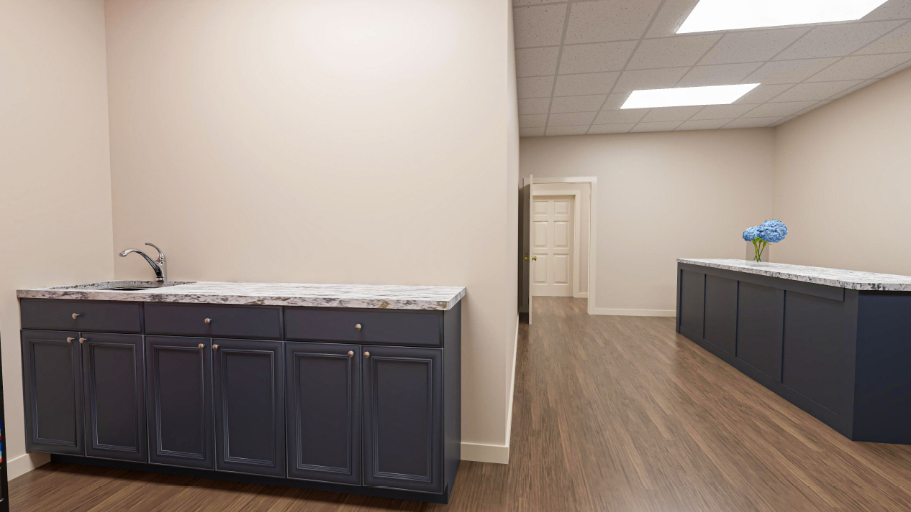

Slide 32
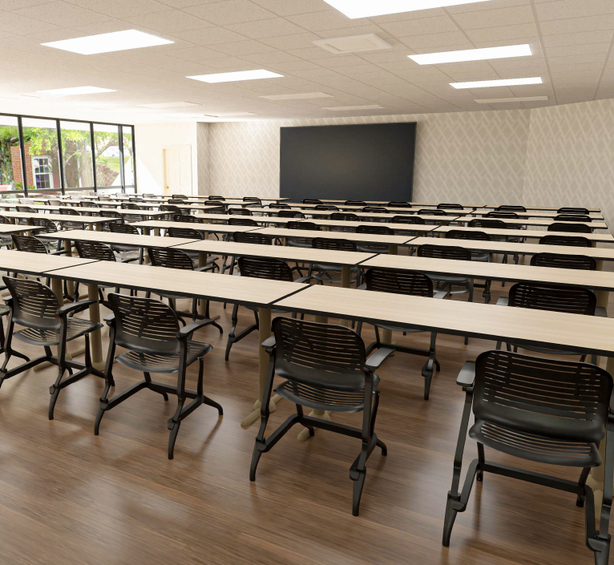
Education Center
163 inch LED Video Wall.
New speakers, microphones, and two cameras .
Confidence monitor for instructors.
Dedicated podium with PC to ensure consistent and easy-to-manage experience.

Slide 33
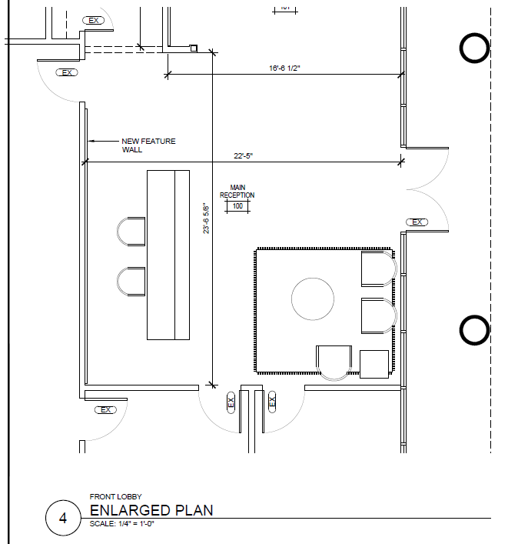
Reception Area
Remove airlock to open up the space and provide easier access to the store.
Remove built-in desk that makes staff feel inaccessible.
More comfortable seating area for members.

Slide 34
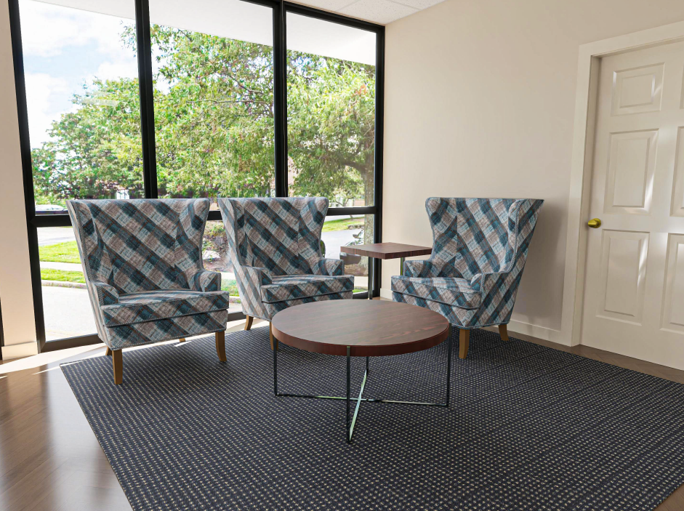
Reception Area
Remove airlock to open up the space and provide easier access to the store.
Remove built-in desk that makes staff feel inaccessible.
More comfortable seating area for members.

Slide 35
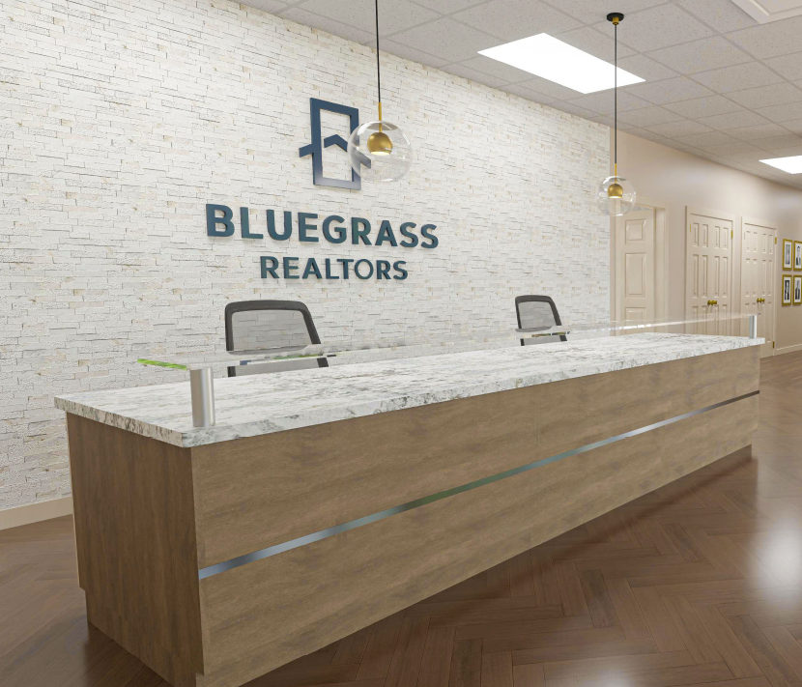
Reception Area
Pocket doors through the store lead to Casual Meeting Room.
Stacked marble, rough cut façade with Association logo creates “WOW!” first impression.

Slide 36
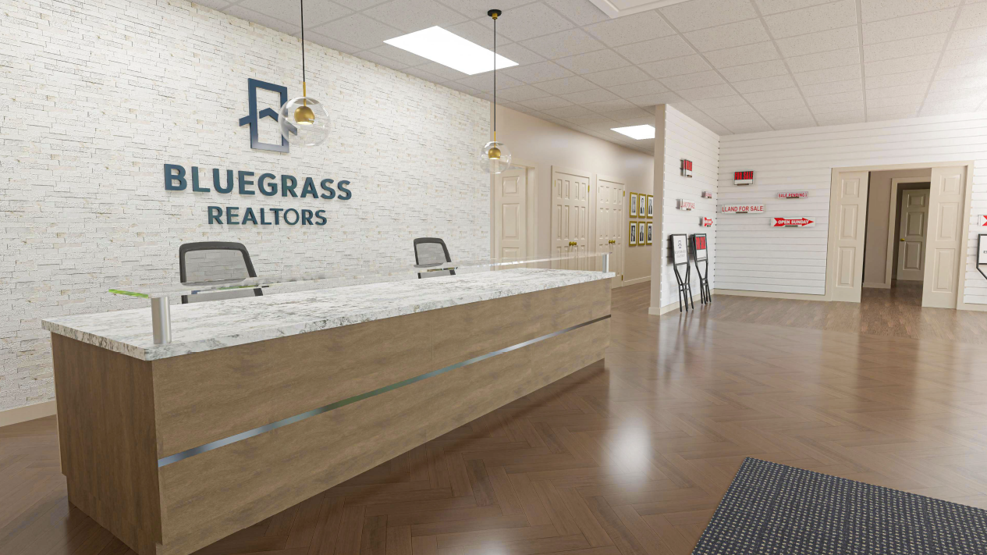
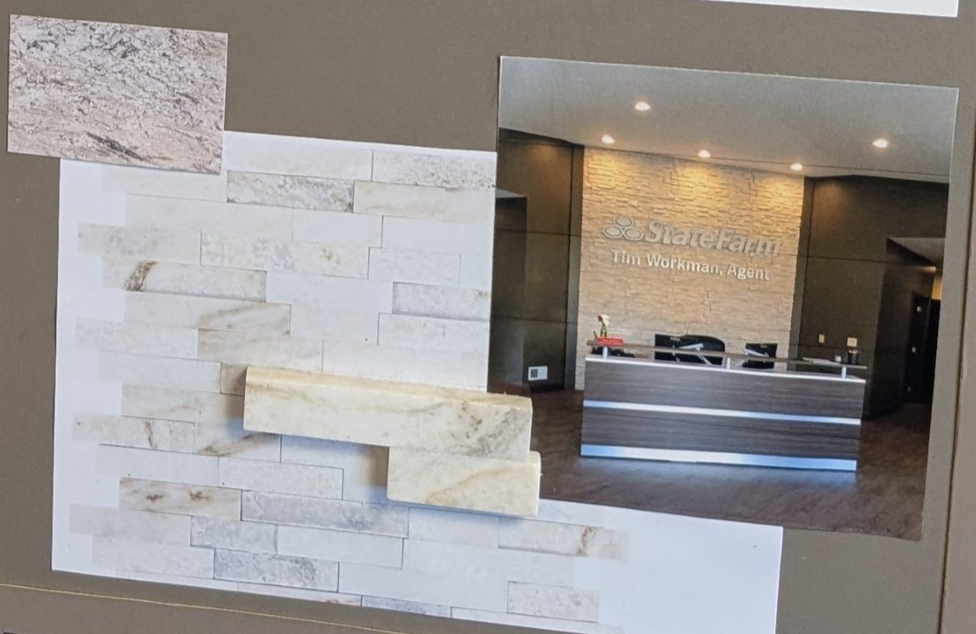
Reception Area
Pocket doors through the store lead to Casual Meeting Room.
Stacked marble, rough cut façade with Association logo creates “WOW!” first impression.

Slide 37
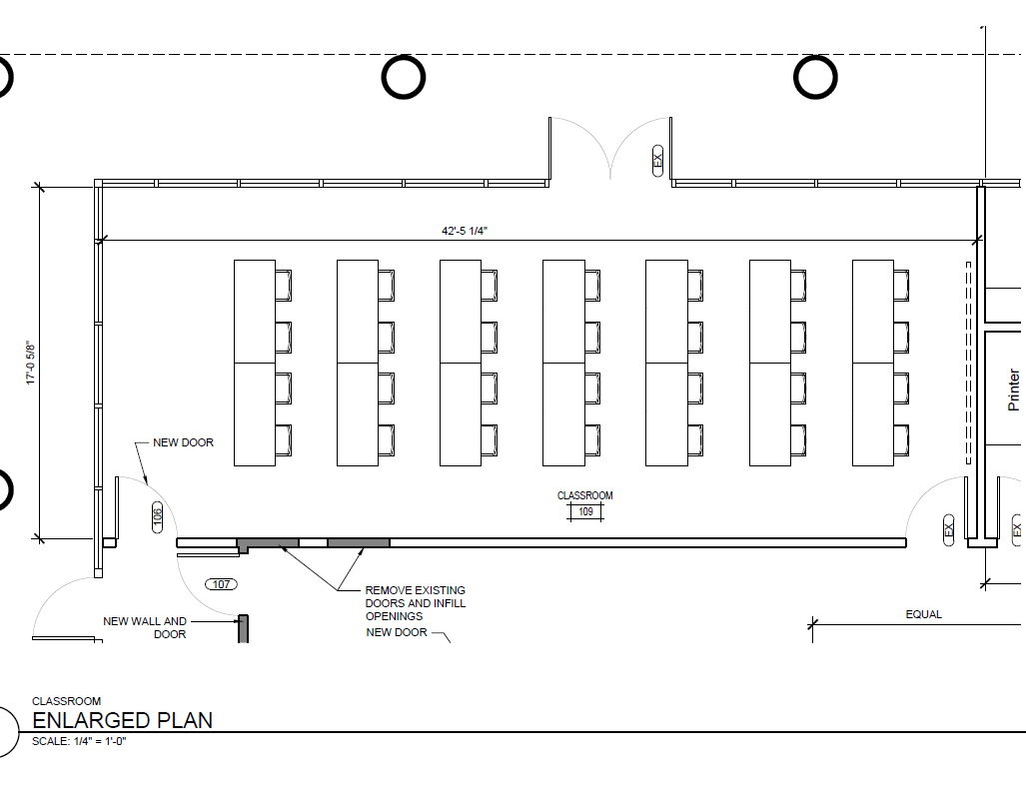
Additional Classroom
Provide more flexibility for hosting smaller classes and sessions.
Tables are on casters and can nested, so room can easily be changed to multiple configurations.
Gives brokerages another option for holding sales and office meetings in addition to the larger education center.

Slide 38
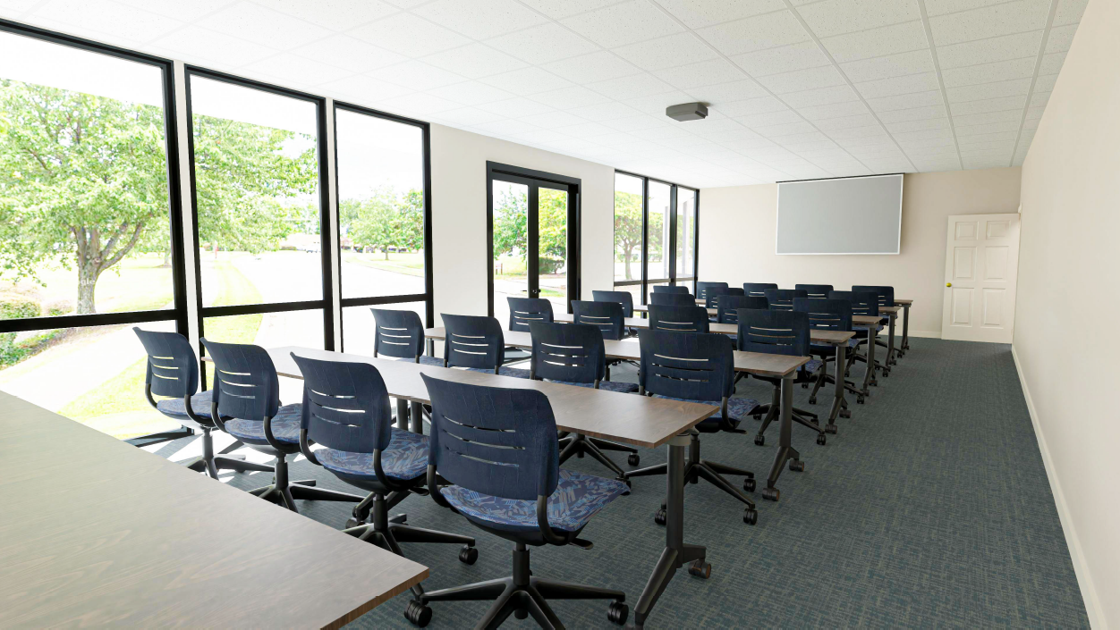
Reception Area
Pocket doors through the store lead to Casual Meeting Room.
Stacked marble, rough cut façade with Association logo creates “WOW!” first impression.

Slide 39
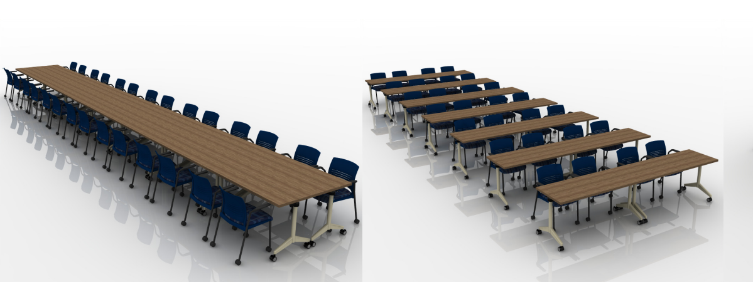
Additional Classroom
Provide more flexibility for hosting smaller classes and sessions.
Tables are on casters and can nested, so room can easily be changed to multiple configurations.
Gives brokerages another option for holding sales and office meetings in addition to the larger education center.

Slide 40
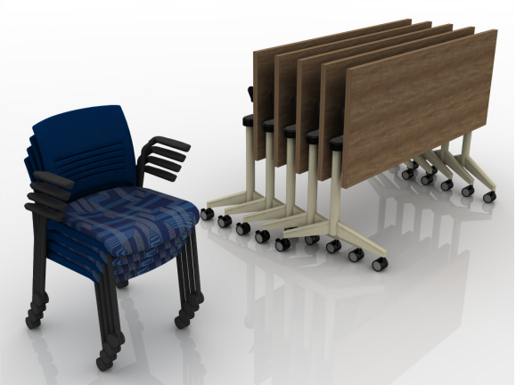
Additional Classroom
Provide more flexibility for hosting smaller classes and sessions.
Tables are on casters and can nested, so room can easily be changed to multiple configurations.
Gives brokerages another option for holding sales and office meetings in addition to the larger education center.

Slide 41
Additional Classroom
Provide more flexibility for hosting smaller classes and sessions.
Tables are on casters and can nested, so room can easily be changed to multiple configurations.
Gives brokerages another option for holding sales and office meetings in addition to the larger education center.

Slide 42
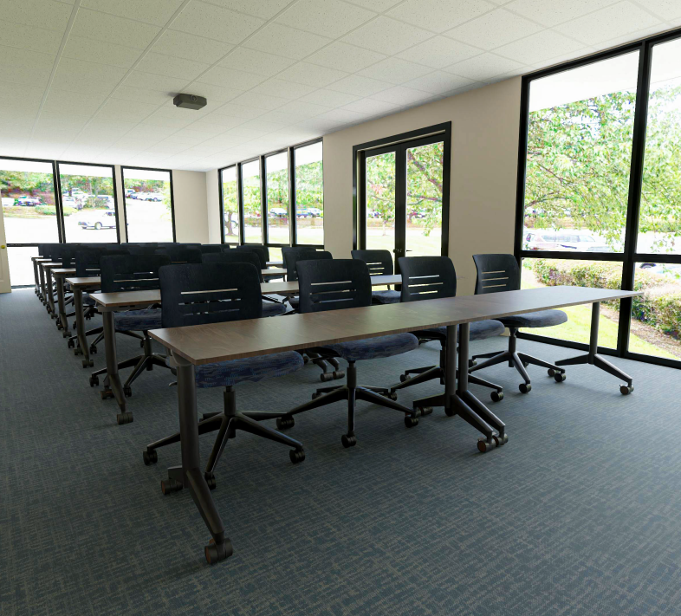
Additional Classroom
Relocating existing projector and screen to this space for cost savings.
New Speakers and microphones, reusing existing audio equipment where feasible.

Slide 43
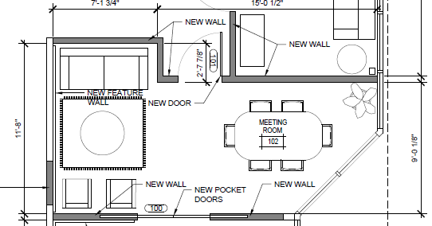
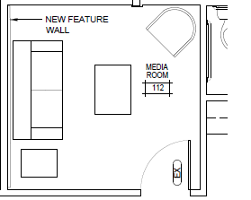
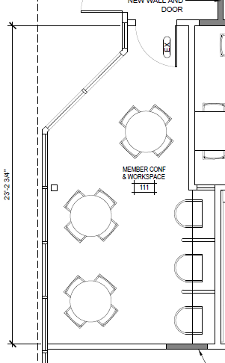
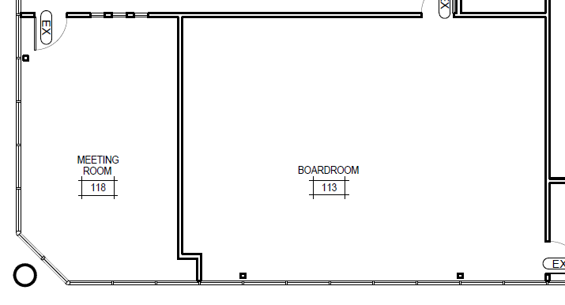
Five Enhanced Member Areas
Casual Meeting Room
Dedicated Studio
Member Workspace
Board Room
Regency Room

Slide 44
Casual Meeting Room
Cozy space near the front of the building.
Perfect for 4-6 person meetings.
Pocket Doors open to Reception/Store area.
Notes:
Coffee Machine in the space to invite hanging out?

Slide 45
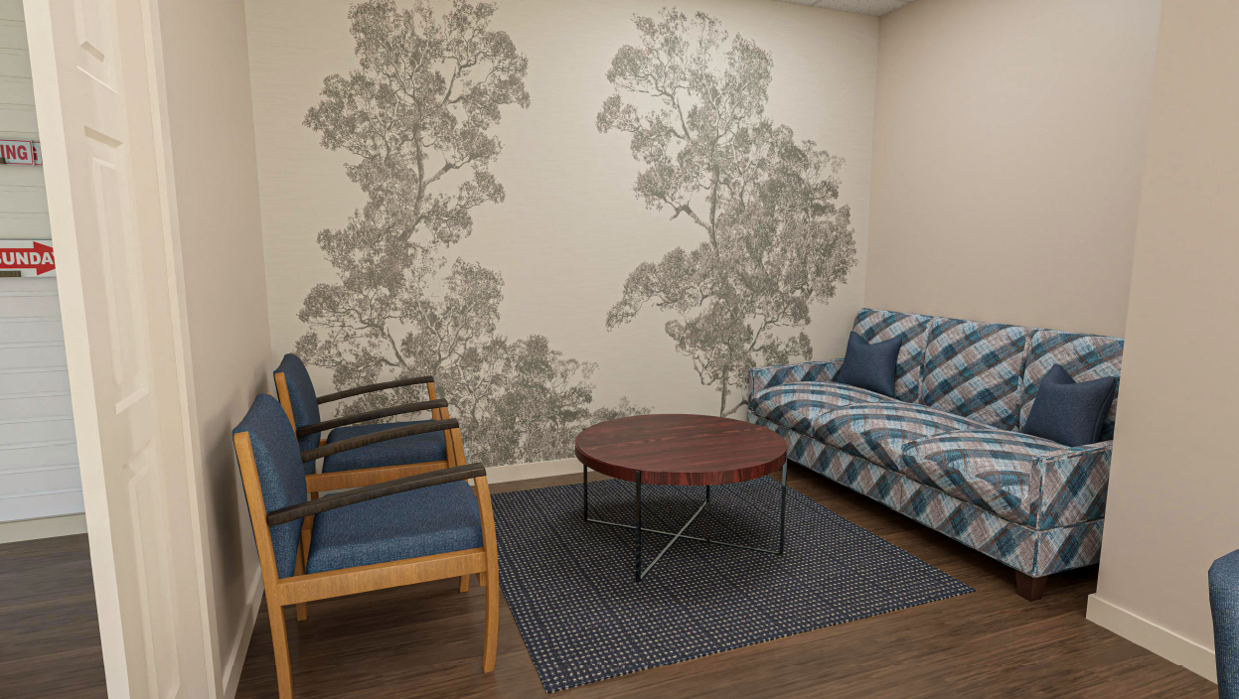
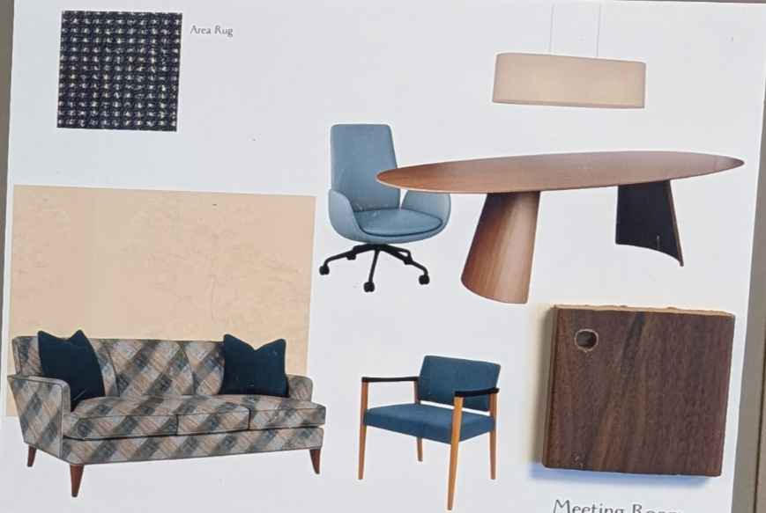
Casual Meeting Room
Cozy space near the front of the building.
Perfect for 4-6 person meetings.
Pocket Doors open to Reception/Store area.

Slide 46
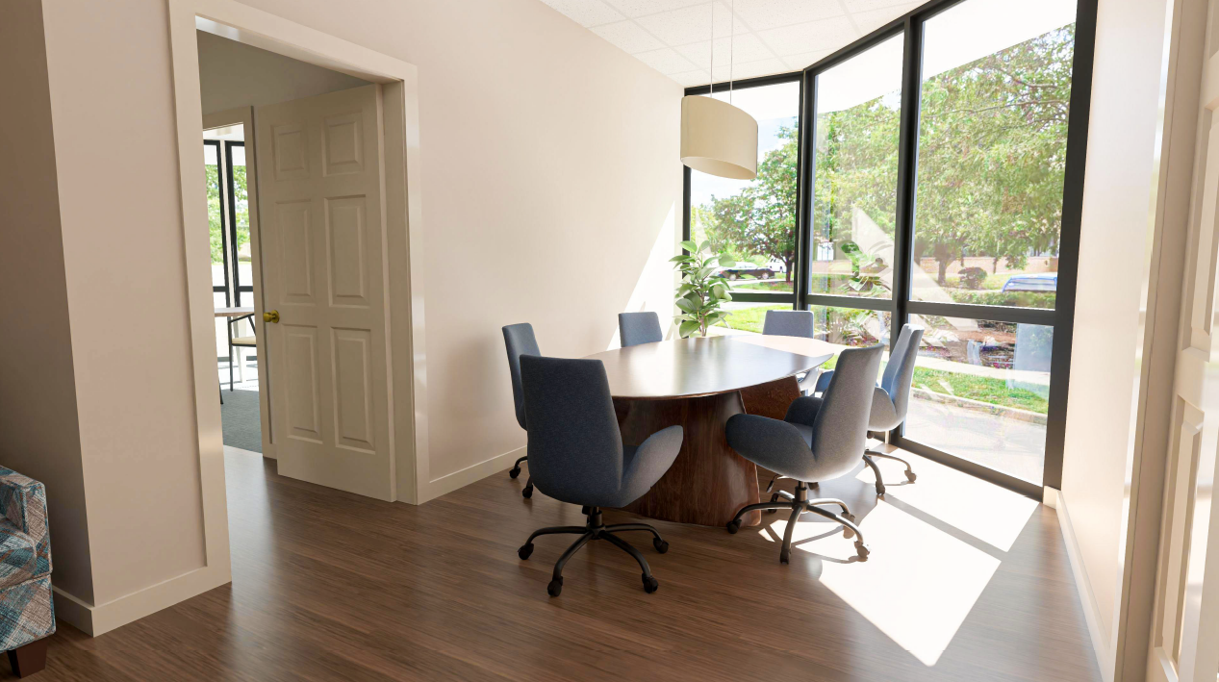
Casual Meeting Room
Cozy space near the front of the building.
Perfect for 4-6 person meetings.
Pocket Doors open to Reception/Store area.

Slide 47
Dedicated Studio
Part of our focus to lean more into video.
Dedicated space with a nice backdrop and dedicated lighting in the space.
Also available for member use.

Slide 48
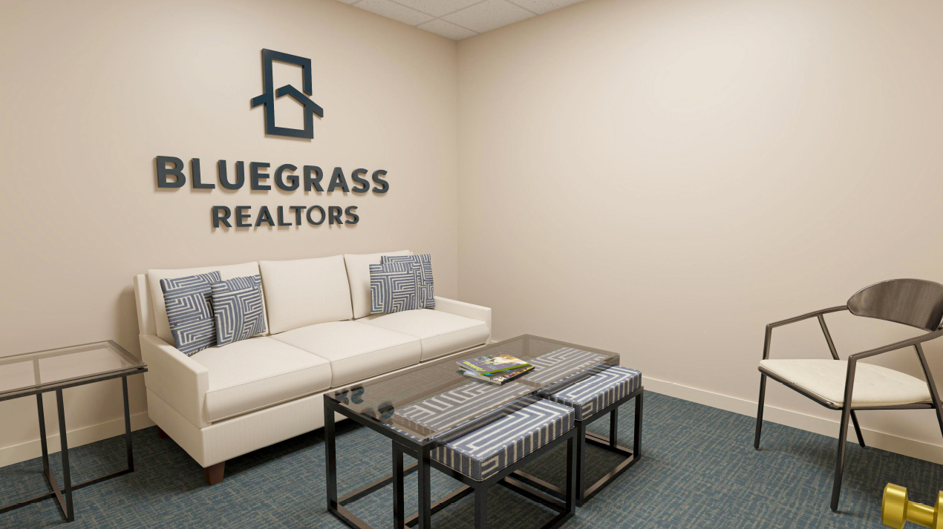
Casual Meeting Room
Cozy space near the front of the building.
Perfect for 4-6 person meetings.
Pocket Doors open to Reception/Store area.

Slide 49
Member Workspace
24/7 Access
More seating, all new furniture.
Complete with computers and printer for after hours needs.

Slide 50
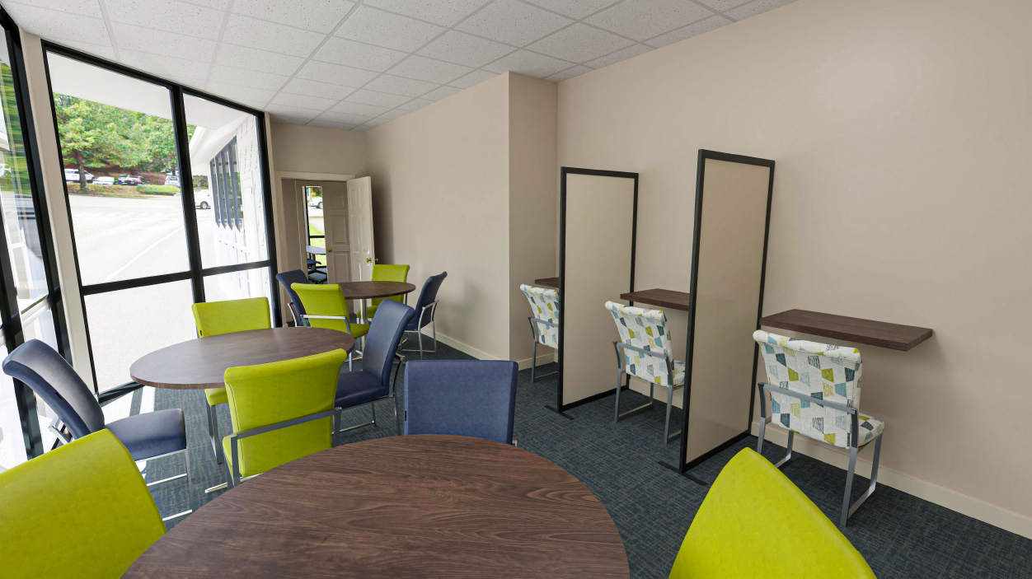
Casual Meeting Room
Cozy space near the front of the building.
Perfect for 4-6 person meetings.
Pocket Doors open to Reception/Store area.

Slide 51
Board Room
Updated Technology to make the space fully hybrid.
New 110” Display, in ceiling mics, dedicated camera, new speakers.
NOT just for the Directors! Committees utilize this space, and all members can reserve it as well.

Slide 52
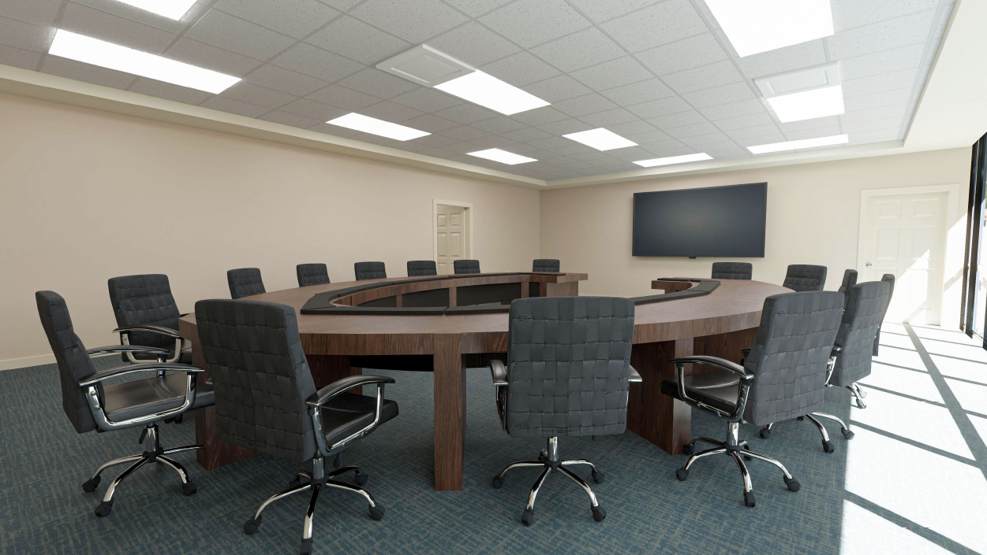
Board Room
Updated Technology to make the space fully hybrid.
New 110” Display, in ceiling mics, dedicated camera, new speakers.
NOT just for the Directors! Committees utilize this space, and all members can reserve it as well.

Slide 53
Regency Room
Perfect for 8-12 person meetings.
New projector with wireless connectivity.
New conference table and chairs.

Slide 54
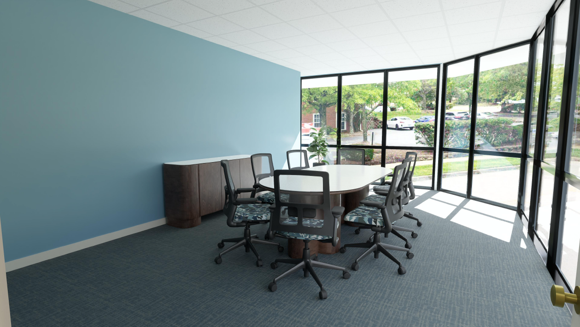

Slide 55
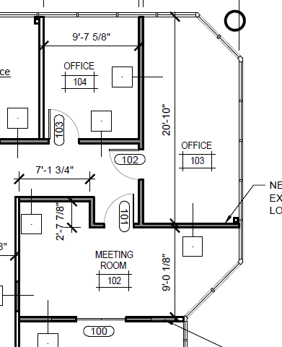
Other Changes
Better utilization of space for the store. Store will still be available with all inventory we have now.
Two new offices to replace the ones that were lost for the second classroom.
Casual Meeting Room is also up here.

Slide 56
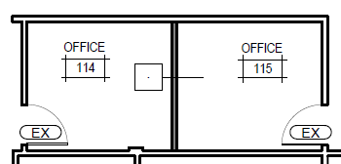
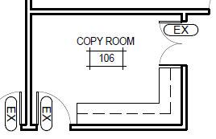
Other Changes
Wall added to old member cubicle space to add two more staff offices.
Copy Room moved to a smaller space. Old copy room will become storage for tables/chairs for Education Center so we have multiple options for flexibility.

Slide 57
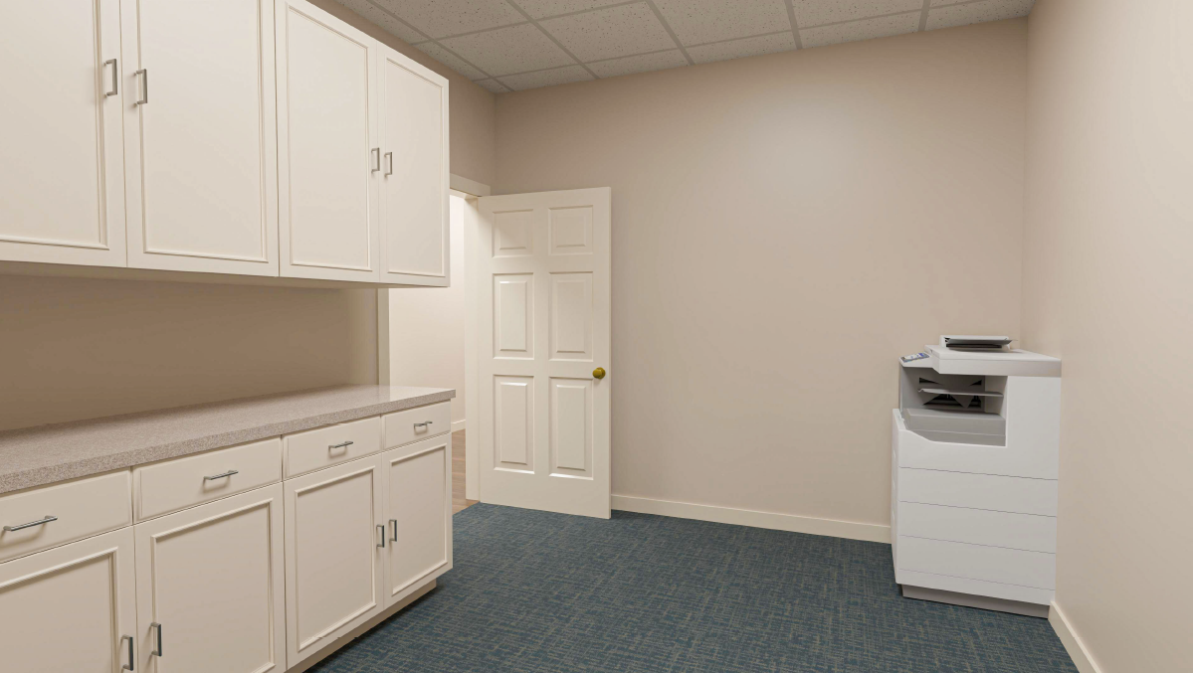

Slide 58
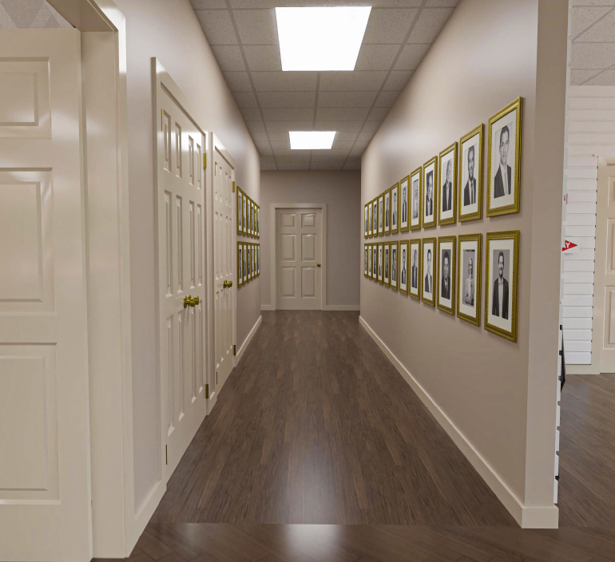
Whole Building
New Flooring throughout
Luxury Vinyl Plank in:
Reception
Hallways
Education Center
Casual Meeting Room
Retail Space
All other areas are carpet tiles for easy maintenance.

Slide 59
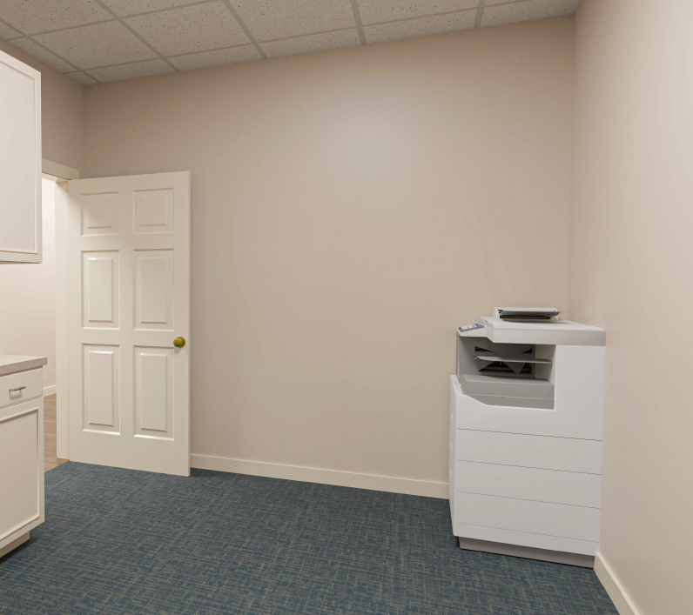
Whole Building
New Flooring throughout
Luxury Vinyl Plank in:
Reception
Hallways
Education Center
Casual Meeting Room
Retail Space
All other areas are carpet tiles for easy maintenance.

Slide 60
Whole Building
Everything refreshed
All new ceiling tiles
All new LED light fixtures
All new light switches
Remove wallpaper and repaint

Slide 61
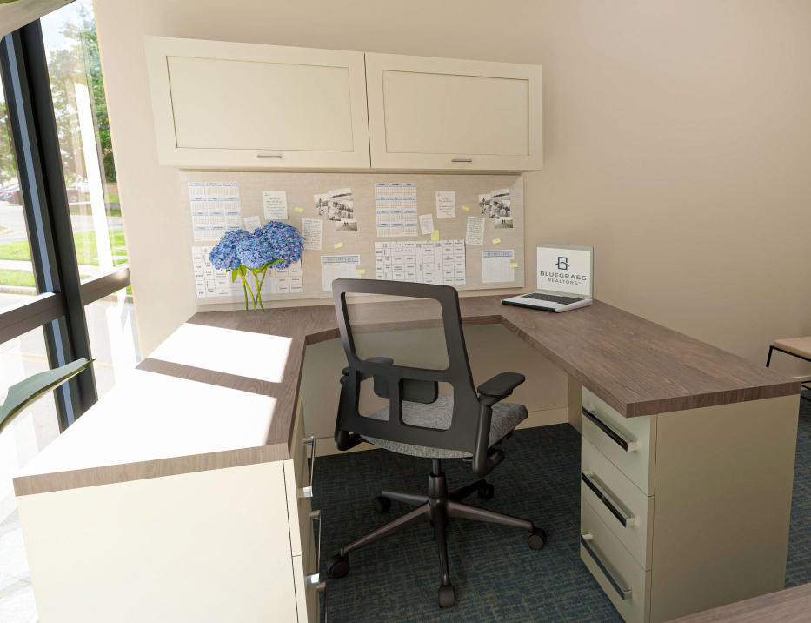
Whole Building
New Staff Office Furniture
Gives a consistent feel throughout the building
Many different decades of furniture throughout the building right now.

Slide 62
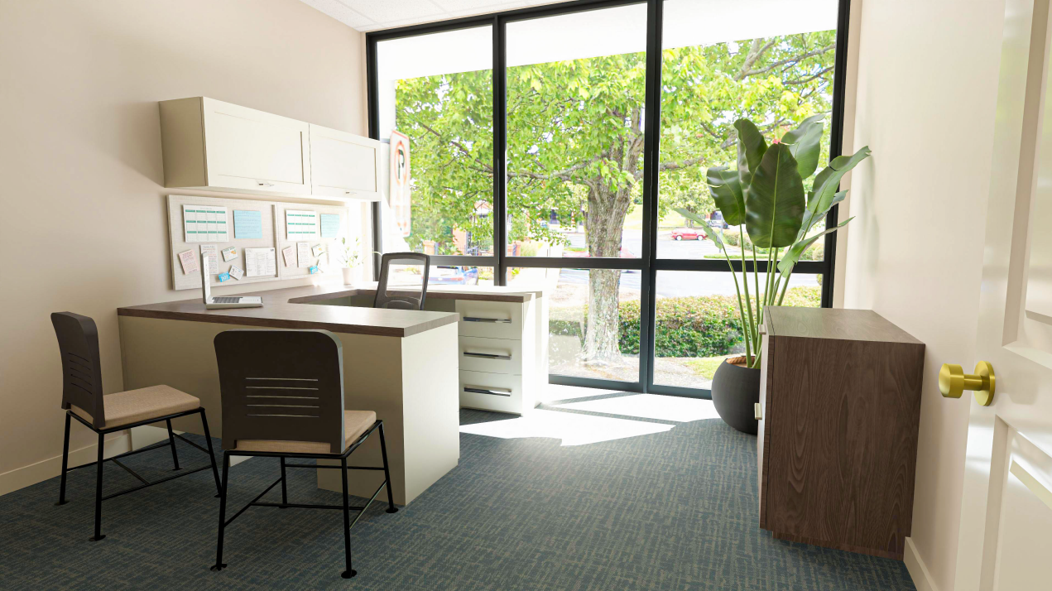

Slide 63
Places We Saved $
No relocation of existing utilities
No work in bathrooms
No utility work in Kitchen
Refinishing doors and trim
No new sprinklers necessary
Retaining Education Center and Board Room Furniture
Reusing some existing Tech
Minimal demo and new walls

Slide 64
Questions?

